Slide 1
Python Scripting
Mustafa Abdulaziz Hamza

Slide 2

Agenda
Dealing with Command-Line Arguments
Interacting with Operating Systems (and such stuff!)
MySQL Connector
Hashing
Cryptography
Resources
Labs

Slide 3
Dealing with command-line arguments
The sys module in Python provides an attribute list that contains all command-line arguments passed to the script, but it does not provide a mean to parse those arguments.
Python also provides a module called argparse, this module provides a simple interface to parse command-line arguments and flags.
The interface provided by this module is an ArgumentParser object, which supports a variety of methods to be used according to your needs.

Slide 4
Argparse Module
add_argument() method is used to add a new command-line argument.
parse_arge() method runs the parser and places the extracted data in a argparse.Namespace object so that you can apply your logic.
import argparse as ar
des = 'This prgram is used to add or subtract two numbers'
arg_parser = ar.ArgumentParser(description=des)
arg_parser.add_argument('-n1', '--num1', required=True, help='First number.')
arg_parser.add_argument('-n2', '--num2', required=True, help="Second number.")
arg_parser.add_argument('-s', '--subtract', action='store_true', help="To enable subtraction mode.")
arg = arg_parser.parse_args()
n1 = int(arg.num1)
n2 = int(arg.num2)
if arg.subtract: print(n1 - n2)
else: print(n1 + n2)

Slide 5
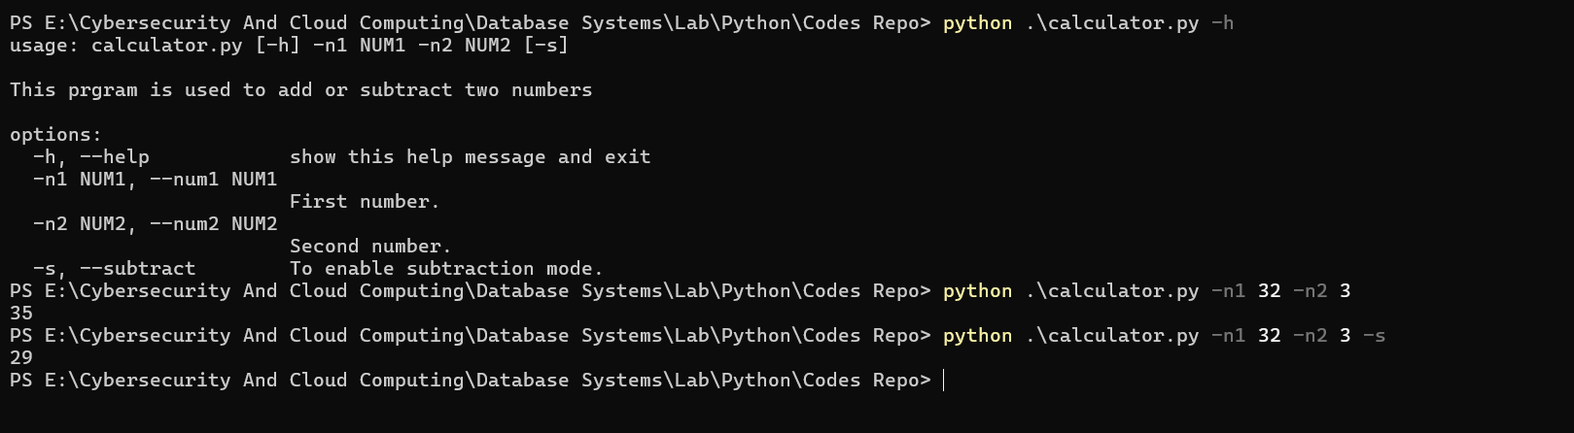
Output

Slide 6

Interacting with Operating Systems
Python provides several modules to interact with the Operating System, including OS and subprocess modules.
The OS module includes functions that are used to perform various operations, such as creating a directory, removing a file, and determining the existence of a file.
The subprocess module is used to run shell commands specific to the operating system in a sub-process and parse their output.

Slide 7
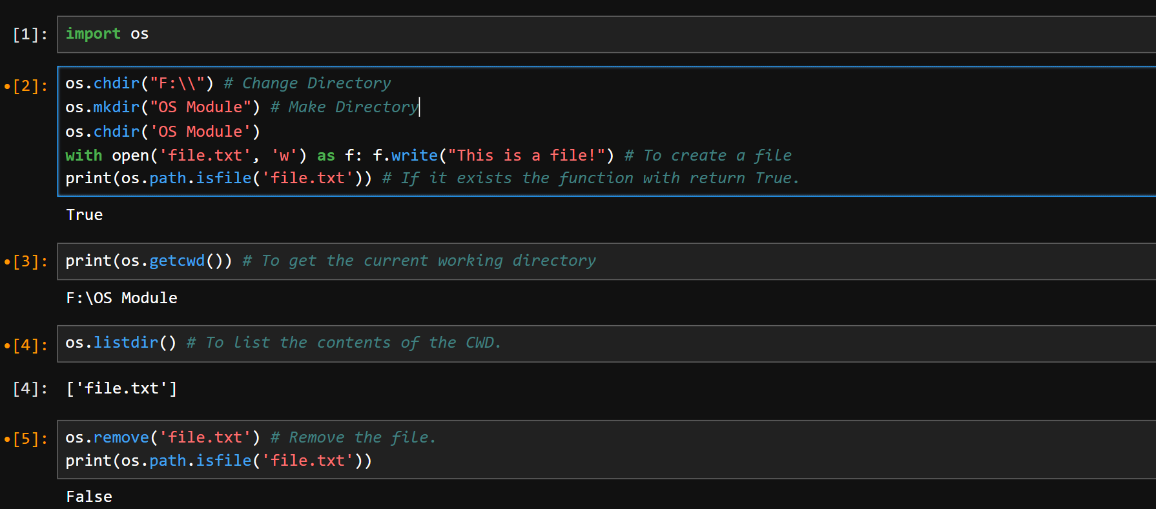
os Module

Slide 8
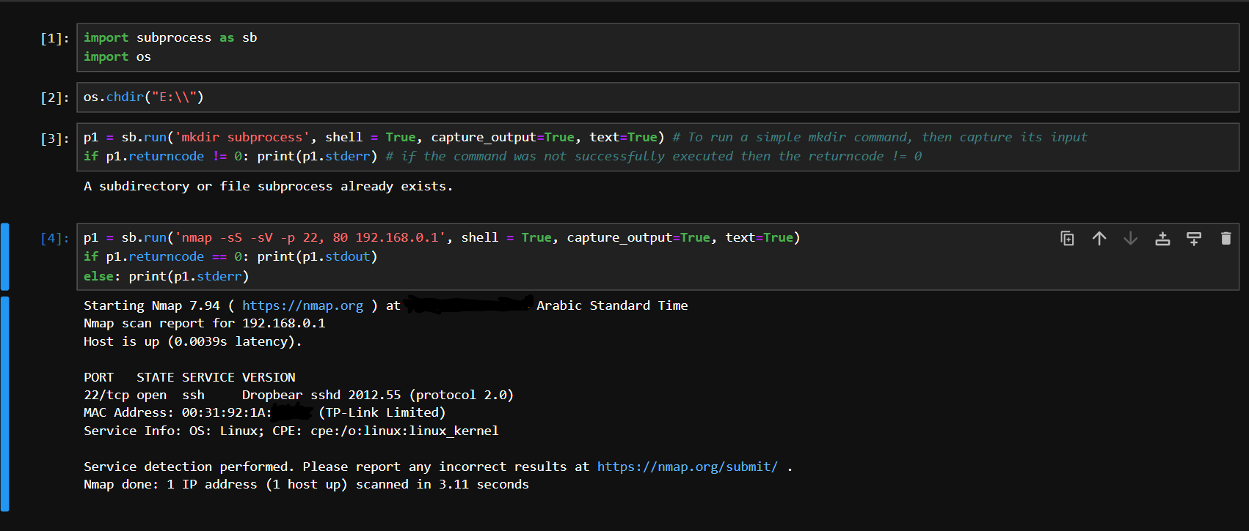
Subprocess

Slide 9
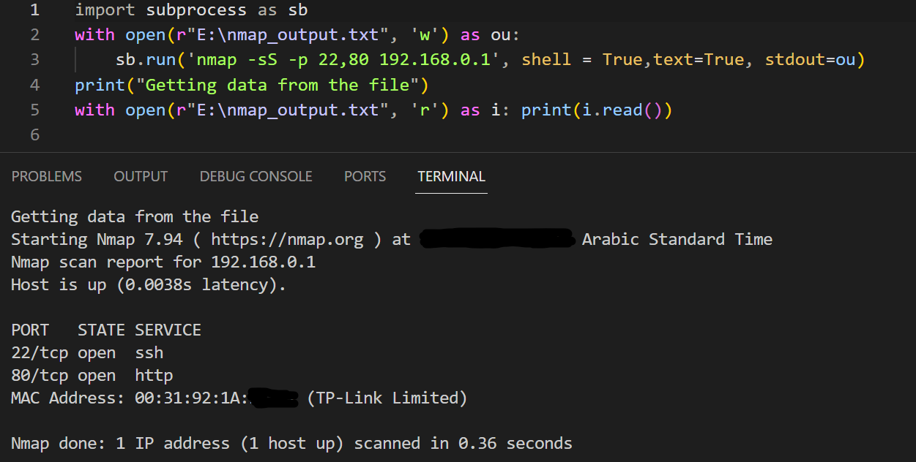
Subprocess
To redirect the output of a command to a file.
Alternatively, if you want to store only the stdout in a variable, you can use stdout=subprocess.PIPE

Slide 10
Let`s develop a terminal emulator!
import subprocess as sb
import os
import sys
from colorama import Fore, init
init(autoreset=True)
while True:
try:
loc = os.getcwd() # To get the current working directory
cmd = input(Fore.GREEN+f"{loc} >"+Fore.RESET)
if cmd.lower() in ['exit', 'q']:
sys.exit(0) # Exit the script

Slide 11
Let`s develop a terminal emulator!
if cmd.split()[0].lower() == 'cd': # Why?
directory = cmd.split()[1]
if os.path.isdir(directory): # Is a directory?
os.chdir(directory)
else:
print(Fore.RED+"The directory {} was not found".format(directory))

Slide 12
Let`s develop a terminal emulator!
else:
p1 = sb.run(cmd, shell=True, text=True, capture_output=True)
if p1.returncode == 0: print(p1.stdout)
else: print(Fore.RED+f"{p1.stderr}")
except KeyboardInterrupt:
print(Fore.RED+"You must enter `exit` or `q` to exit the terminal.")
except IndexError: pass
except Exception as e: print(Fore.RED+f"{e}")

Slide 13
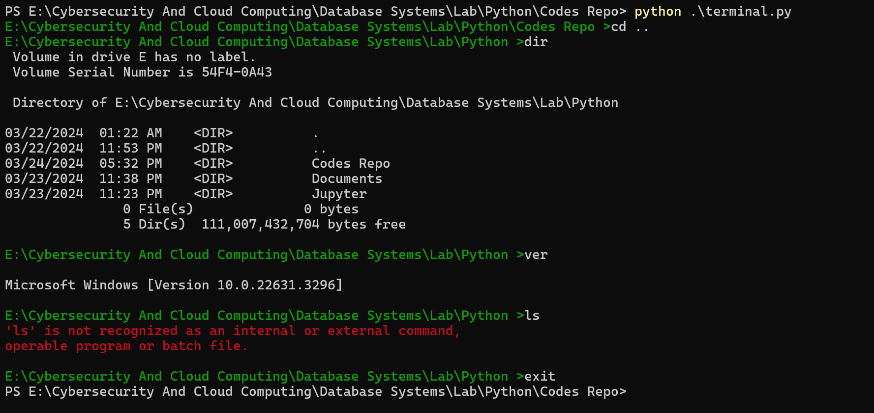
Run the terminal emulator

Slide 14

MySQL Connector
MySQL Connector is a Python library enables Python programs to access MySQL databases
This library includes functions dedicated to access MySQL server, execute SQL commands, and fetch data returned by the commands.
To install MySQL Connector/Python using pip:
pip install mysql-connector-python

Slide 15
Connecting to MySQL Server
The connect() constructor creates a connection to the MySQL server and returns a MySQLConnection object.
import mysql.connector as mysql
db = mysql.connect(user='root', password='password', host='127.0.0.1')
db.close()

Slide 16
Cursor
To create a Cursor object use the cursor() method of the Connection object.
The Cursor object can be used to execute SQL commands directly from within the Python code.
After executing the required commands, it’s essential to close the cursor object.
You can also use a context manager to automatically close the cursor when it goes out of scope.
cur = db.cur()
# Block of code
cur.close()
with db.cursor() as cur:
# Block of code
pass

Slide 17
CREATE TABLE …
To create a table using a Cursor object:
import mysql.connector as mysql
db = mysql.connect(user='root', password='password', host='127.0.0.1')
cur = db.cursor()
cur.execute("CREATE DATABASE Company;")
cur.execute('USE Company;')
cur.execute("""CREATE TABLE Employees(emp_ID INT PRIMARY KEY AUTO_INCREMENT,
first_name VARCHAR(15) NOT NULL, last_name VARCHAR(15) NOT NULL);""")
cur.close()
db.close()

Slide 18
INSERt…into
To insert data into tables we also use the Cursor object.
We should commit any changes on database before closing the Cursor object.
import mysql.connector as mysql
db = mysql.connect(user='root', password='password', host='127.0.0.1')
with db.cursor() as cur:
cur.execute('USE Company;')
cur.execute("INSERT INTO Employees(first_name, last_name) VALUES('Ahmed', 'Khaled'), ('Salim', 'Hassan');")
db.commit()
db.close()

Slide 19
SELECT…FROM
Use the Cursor object to query data by executing `SELECT … FROM` command, then fetch the output using the fetchall() method.
import mysql.connector as mysql
db = mysql.connect(user='root', password='password', host='127.0.0.1')
with db.cursor() as cur:
cur.execute('USE Company;')
cur.execute("SELECT * FROM Employees;")
data = cur.fetchall()
print(data) # [(1, 'Ahmed', 'Khaled'), (2, 'Salim', 'Hassan')]
first_names = [name[1] for name in data]
print(first_names) # ['Ahmed', 'Salim']
db.close()

Slide 20

hashlib
Hash functions take an input of variable length and produce a fixed-size output, commonly referred to as a “digest.”
Hashlib Python module implements a common interface to many different secure hash and message digest algorithms.

Slide 21
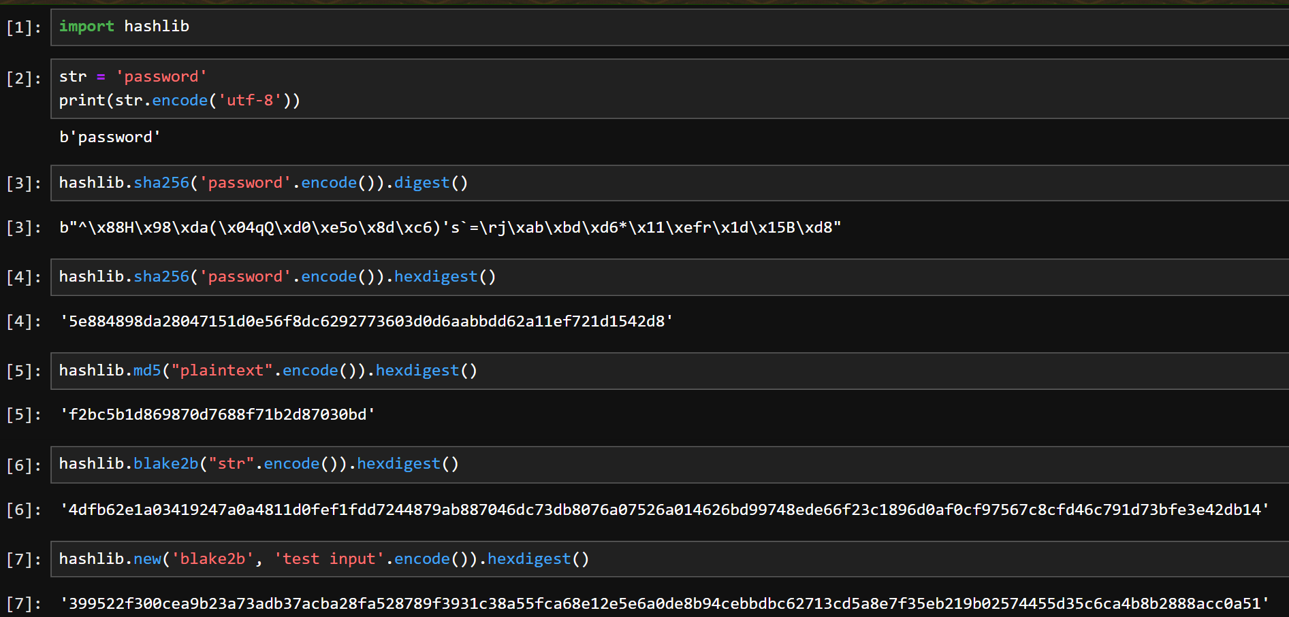
Hashlib

Slide 22
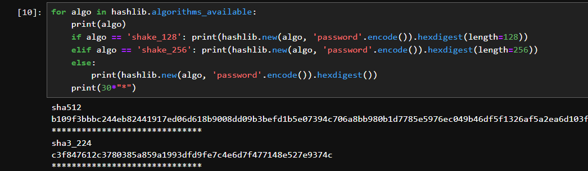
Hashlib

Slide 23
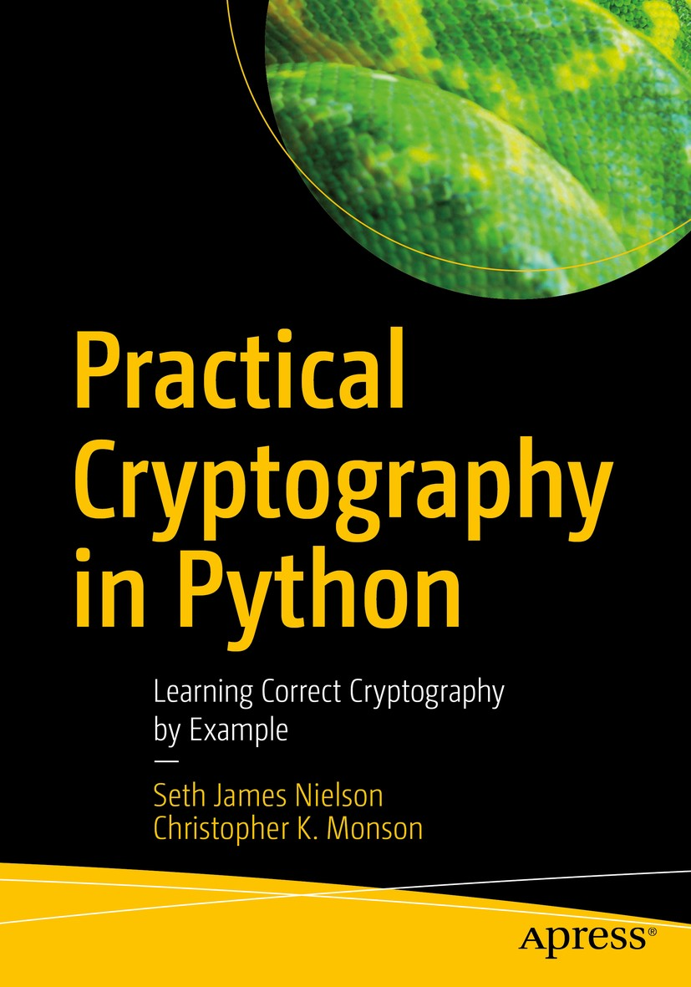
cryptography
Cryptography is a package which provides cryptographic recipes and primitives to Python developers.
Cryptography includes both high level recipes and low level interfaces to common cryptographic algorithms such as symmetric ciphers, message digests, and key derivation functions.

Slide 24
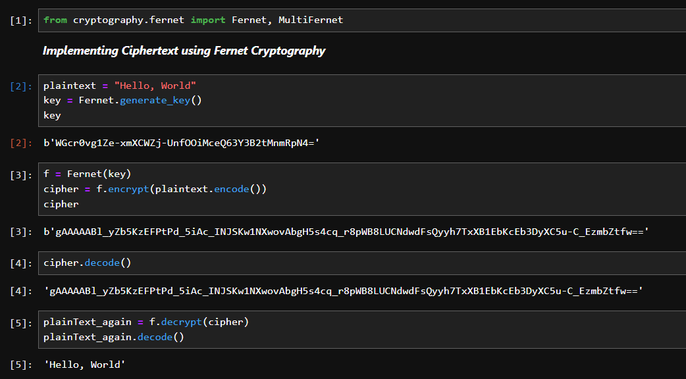
Cryptography

Slide 25
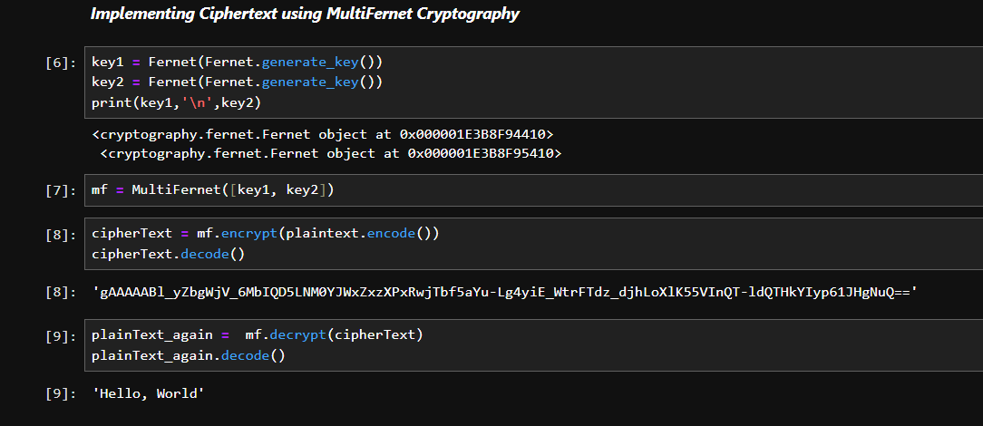
Cryptography

Slide 26

Resources
CS Resources Channel on Telegram which is owned by MUSTAFA ABDULAZIZ (who is me BTW):
Link
Link also
Link also, but pink and within the logo

Slide 27

Resources- Code Repo and more
All Python and Jupyter files related to this lecture was uploaded to my personal Github account:- Link
Python Tutorial: VENV (Mac & Linux) by Corey Schafer Link
Jupyter Notebook Tutorial: Introduction, Setup, and Walkthrough by Corey Schafer:- Link
BTW, Prof. Severus Snape was a big fan of Jupyter Notebook.
Source: J. K. Rowling told me

Slide 28

Resources- Books
Python Cookbook 3rd Edition
Learning Python 4th Edition By Mark Lutz
Practical Cryptography in Python
Python Network Programming
Python for Data Analysis 3rd edition By Wes McKinney
Advanced Python Programming
High Performance MySQL 3rd edition
Guido van Rossum The creator of Python

Slide 29
Resources- Documents
Security Discussion Slides By Mustafa Abdulaziz
OS Module Documentation
Subprocess Module Documentation
SQL Connector Documentation Web PDF
Cryptography Documentation Web PDF

Slide 30

labs

Slide 31

Lab 2
Dora has come to search for difficulty in this task!
Write a Python program which has the following features:
It should be used to create a database called `Company`, create a table called Users inside the database containing the following attributes: User ID, Username, and Password, and fill the `Users` table with one record based on user input.
It can also be used to insert a new record into the table `Users` without trying to create the database.
Accepts user input as Command-line arguments.
Encrypts the username using MultiFernet cryptography, and hashes the password using any chosen hashing algorithm.
The data required to decrypt the username should be automatically saved into files at the Current Working Directory so that an optional lab script called `login` could work.

Slide 32
Lab 3
Write a Python program that implements a simple login process using the existing data into the `Users` table. The program should have the following features:
Accepts the input as command-line arguments, with all necessary data provided as input.
The users should enter the login credentials as plaintext.
Once the user is authenticated, the code should provide a means to execute SQL commands.
Do not forget, Least Privileges, All that you have done is nothing if you forget that principle!

Slide 33
Lab 4- Optional
Try to improve the script of Lab 2, so that it builds an entire Company database, and interacts with it by using an improved GUI–based version of the login script.
Note: YOU DO NOT NEAD TO WRITE ALL SQL COMMANDS INSIDE YOUR CODE, YOU CAN USE FOUR LINES OF PYTHON CODE!

Slide 34

Python Scripting

